Slide 1

Task-5: IMDB Movie Analysis

Slide 2
Excel Tasks:
Contents:
Project Description
Tech Stack Used
Approach
Insights
Results and Conclusion
Movie Genre Analysis
Duration Analysis
Language Analysis
Director Analysis
Budget Analysis

Slide 3
Project Description:
The IMDb Movie Analysis project aims to explore and analyze a comprehensive dataset of movies available on the IMDb platform.
This dataset contains essential information about movies, including director names, movie titles, duration, genre, budget, gross earnings, IMDb ratings, and more.
Through in-depth data analysis using Excel, Data Visualization and Statistics techniques this project seeks to extract valuable insights and trends that contribute to a movie's success.
Software Used: Microsoft Excel 365
NOTE: ALL THE LINKS FOR CLEANED DATASET AND SOLUTIONS DATASET ARE PROVIDED BELOW !!!

Slide 4
My Approach:
DATA HANDLING
I have gone through the dataset and understood all the given columns. Then I have observed that there are a total of 28 Columns and 5043 Rows. This dataset consists of unwanted columns, Null values and Blank rows. So, I have decided to Clean this dataset thoroughly.
First, I have deleted the columns which have no relation to our project and don't provide any valuable insights. In the end, I only left with 9 Columns which are director’s name, duration, movie title, genre, budget, gross, IMDB rating, language and country.
Then, I noticed that there were many blank rows. To find them I first clicked on “Find & Select” then clicked on “go to special” and selected the “blank” option. It highlighted all the blank rows. Then I clicked the shortcut “CTRL + - ” and selected the “Entire rows” option. This process deleted the entire blank rows in the dataset.
Finally, I also deleted the duplicate rows present in the dataset. Now, I left with a total of 9 Columns and 3786 Rows.

Slide 5
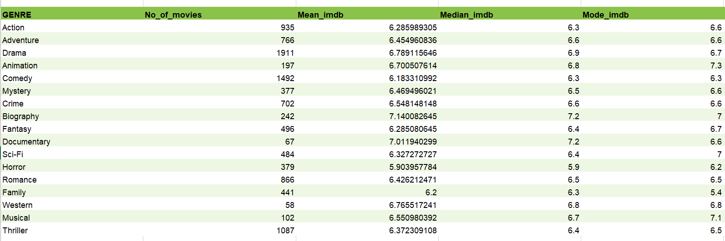
1) Movie Genre Analysis:
DATA ANALYSIS
Analyze the distribution of movie genres and their impact on the IMDB score.
Task: Determine the most common genres of movies in the dataset. Then,
for each genre, calculate descriptive statistics (mean, median, mode, range,
variance, standard deviation) of the IMDB scores.
Results:

Slide 6
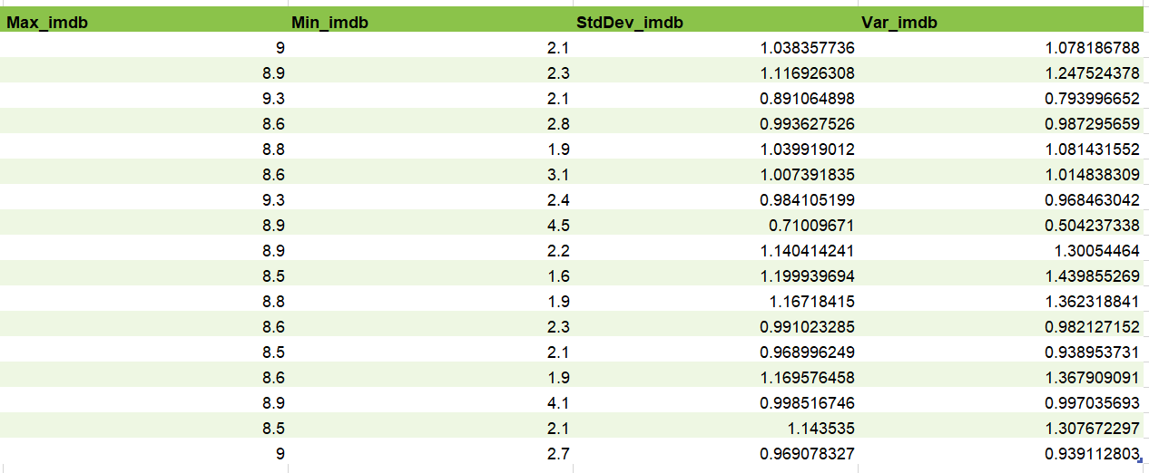
1) Movie Genre Analysis:
DATA ANALYSIS
Result:

Slide 7
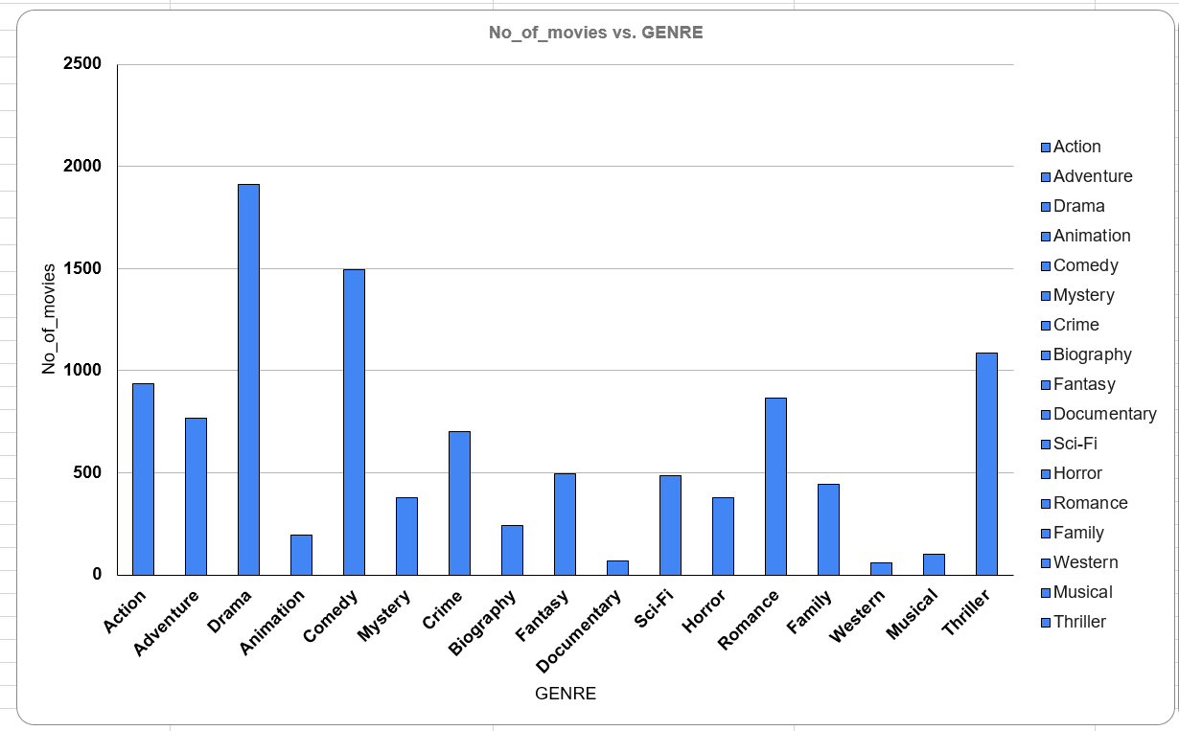
1) Movie Genre Analysis:
DATA ANALYSIS
Result:

Slide 8
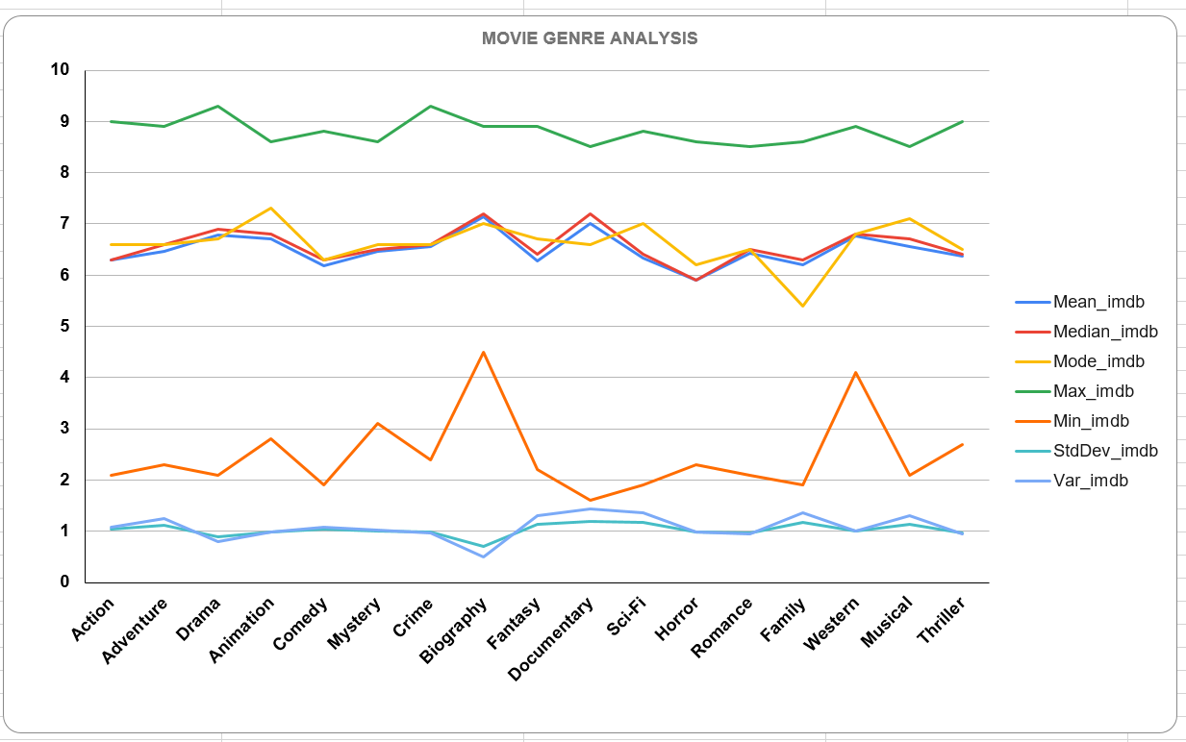
1) Movie Genre Analysis:
DATA ANALYSIS
Result:

Slide 9
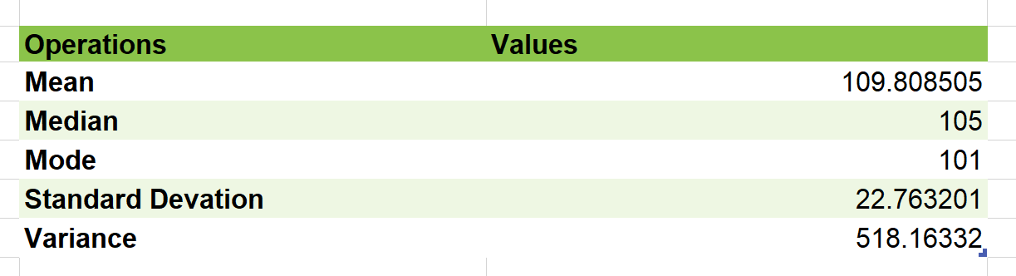
2) Movie Duration Analysis:
DATA ANALYSIS
Analyze the distribution of movie durations and its impact on the IMDB score.
Task: Analyze the distribution of movie durations and identify the relationship
between movie duration and IMDB score.
Results:

Slide 10
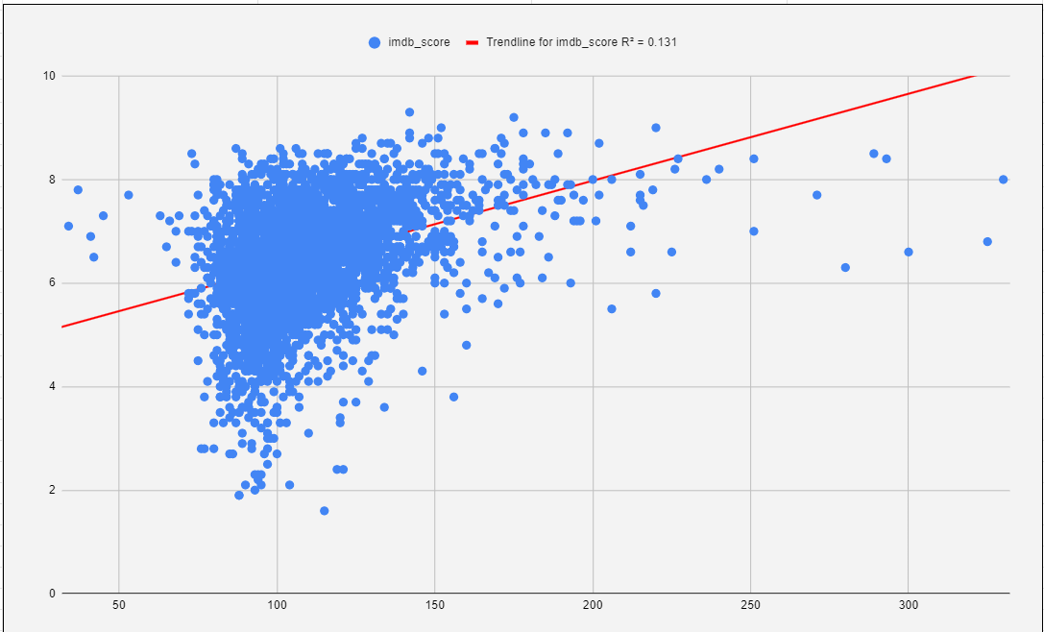
2) Movie Duration Analysis:
DATA ANALYSIS
Analyze the distribution of movie durations and its impact on the IMDB score.
Task: Analyze the distribution of movie durations and identify the relationship
between movie duration and IMDB score.
Results:

Slide 11
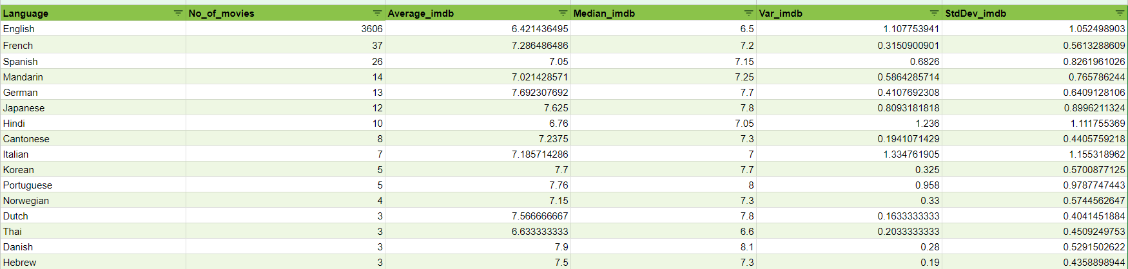
3) Movie Language Analysis:
DATA ANALYSIS
Situation: Examine the distribution of movies based on their language.
Task: Determine the most common languages used in movies and analyze
their impact on the IMDB score using descriptive statistics.
Results:

Slide 12
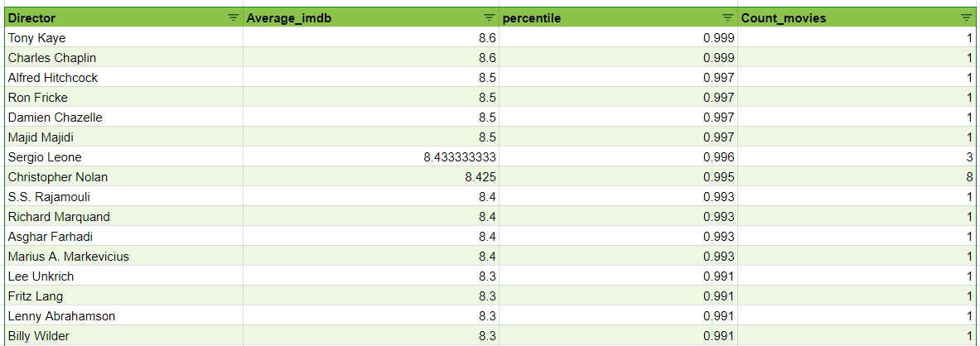
4) Movie Director Analysis:
DATA ANALYSIS
Influence of directors on movie ratings.
Task: Identify the top directors based on their average IMDB score and analyze
their contribution to the success of movies using percentile calculations.
Result:

Slide 13
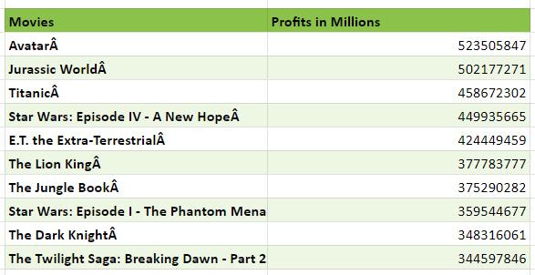
5) Movie Budget Analysis:
DATA ANALYSIS
Explore the relationship between movie budgets and their financial success.
Task: Analyze the correlation between movie budgets and gross earnings, and
identify the movies with the highest profit margin.
Results:

Slide 14
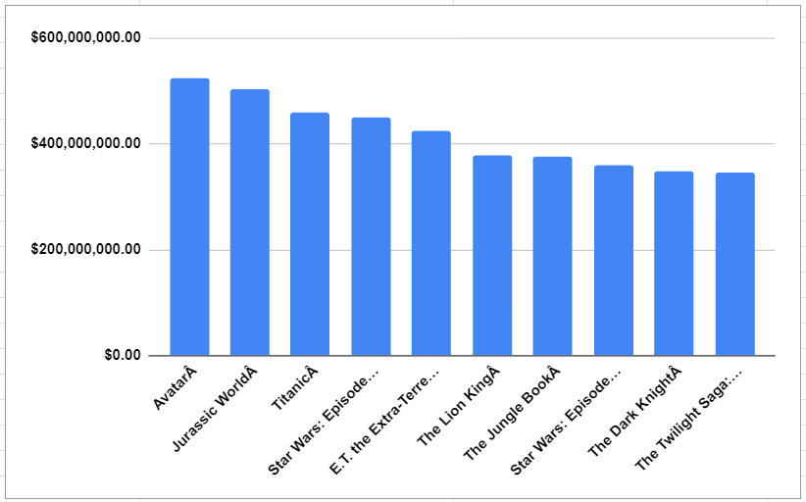
5) Movie Budget Analysis:
DATA ANALYSIS
Explore the relationship between movie budgets and their financial success.
Task: Analyze the correlation between movie budgets and gross earnings, and
identify the movies with the highest profit margin.
Results:

Slide 15
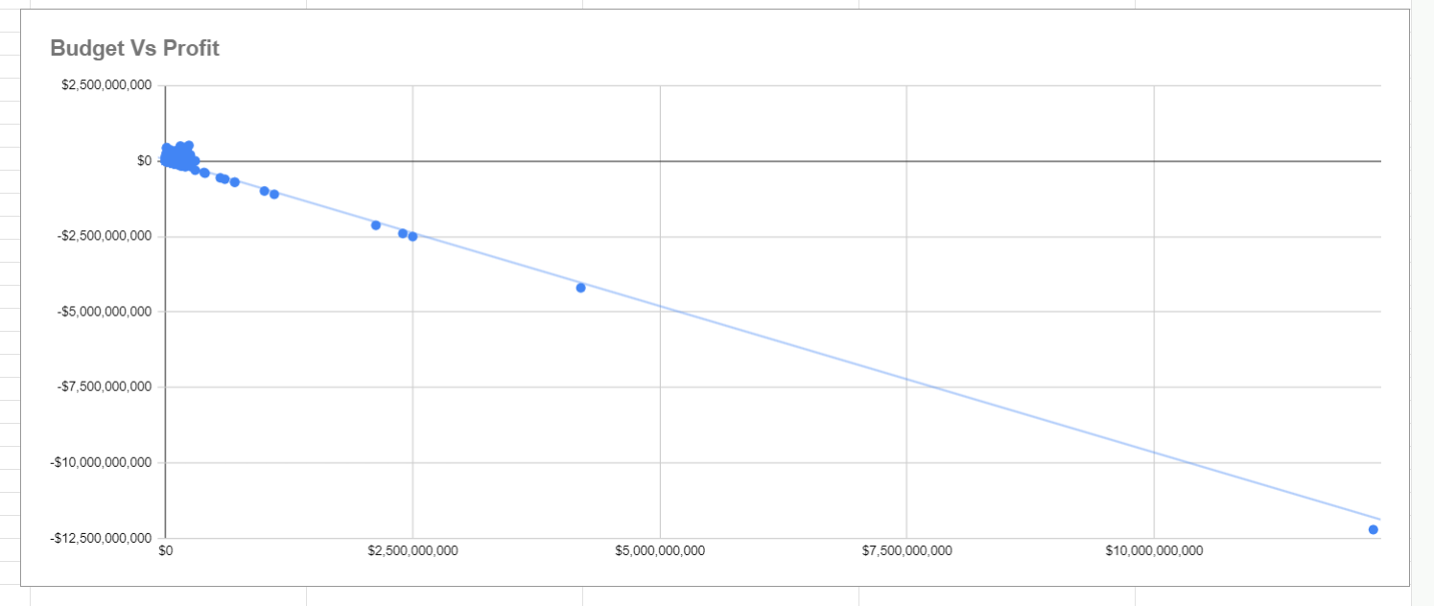
5) Movie Budget Analysis:
DATA ANALYSIS
Explore the relationship between movie budgets and their financial success.
Task: Analyze the correlation between movie budgets and gross earnings, and
identify the movies with the highest profit margin.
Correlation Graph:

Slide 16
Insights
The Most common movie genres from the dataset are Drama, Comedy, Thriller and Action.
The Average duration of a Movie is 109 minutes. The trendline between the duration vs IMDb score is elevated upward with R^2 = 0.131
The Most common languages used in the movies are English, French, Spanish, Mandarin and German. I have also Observed that the languages Telugu and Persian have the highest average IMDb score.
I have identified that Tony Kaye, Charles Chaplin, Alfred Hitchcock, Ron Fricke, Damien Chazelle, Majid Majidi, Sergio Leone, Christopher Nolan, SS Rajamouli and Richard Marquand are the top 10 directors with average IMDb score >=8.4
The Top-5 with highest profits are Avatar, Jurassic World, Titanic, Star Wars: Episode IV - A New Hope and E.T. The Extra-Terrestrial. The Correlation between budget and gross is positive.

Slide 17
Conclusion
The Cleaned Dataset:
https://docs.google.com/spreadsheets/d/1tOce0jydlb237fCkdCivmAhoSbIdUd8S/edit?usp=sharing&ouid=113164427151651167203&rtpof=true&sd=true
The Results Dataset:
https://docs.google.com/spreadsheets/d/1MrNSZpqrZJ4PUmwZdgrQdxL6nGMhseJB/edit?usp=sharing&ouid=113164427151651167203&rtpof=true&sd=true
Thank You

